Slide 1
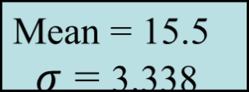
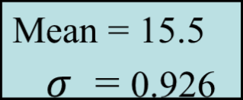
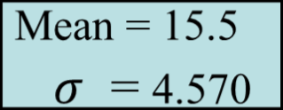
Measures of Dispersion:
Comparing Standard Deviations
Data A
11 12 13 14 15 16 17 18 19 20 21
Data B
11 12 13 14 15 16 17 18 19 20 21
Chap 3-<number>
Data C
11 12 13 14 15 16 17 18 19 20 21

Slide 2
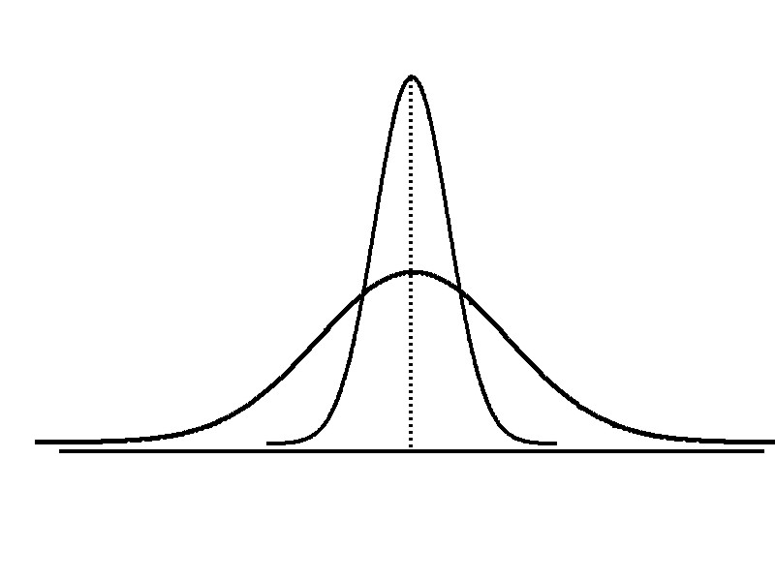
Measures of Dispersion:
Comparing Standard Deviations
Smaller standard deviation
Larger standard deviation
Chap 3-<number>

Slide 3
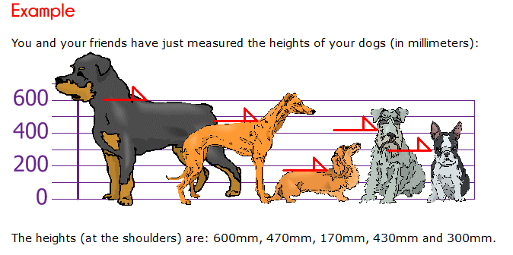

Practical example

Slide 4
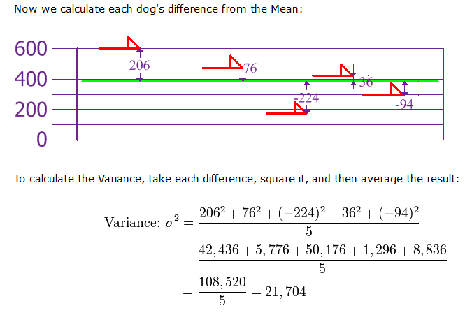
Practical example

Slide 5
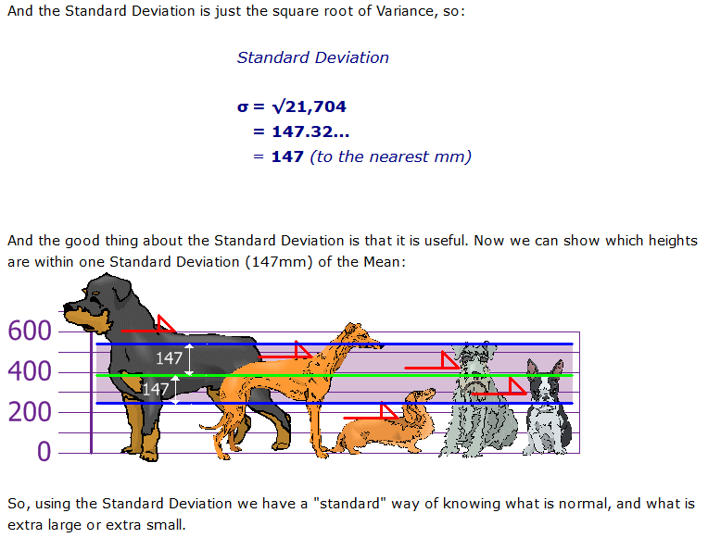

Slide 6
Standard Deviation.
So how do you calculate it?

Slide 7
Two classes took a recent quiz. There were 10 students in each class, and each class had an average score of 81.5
Since the averages are the same, can we assume that the students in both classes all did pretty much the same on the exam?
The answer is… No.
The average (mean) does not tell us anything about the distribution or variation in the grades.

Slide 8
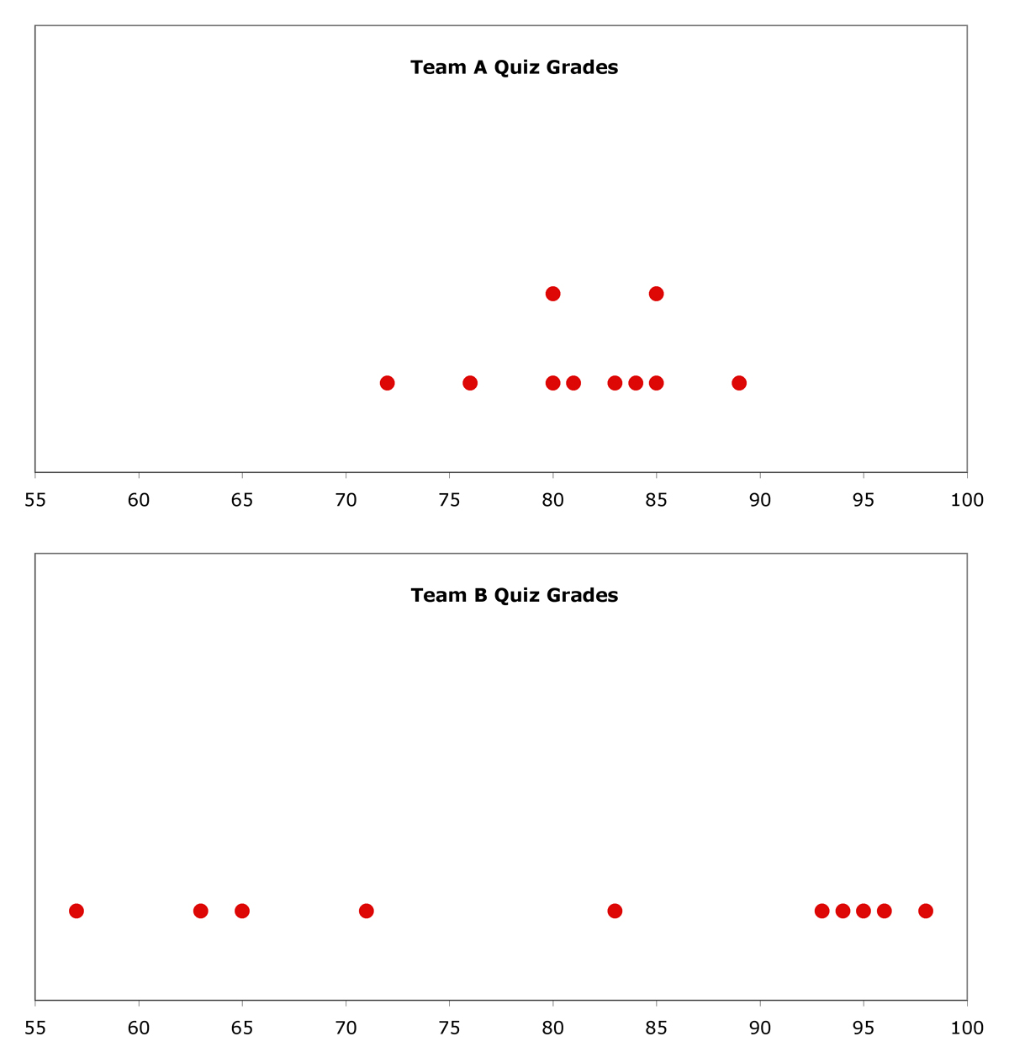
Here are Dot-Plots of the grades in each class:
Mean

Slide 9
So, we need to come up with some way of measuring not just the average, but also the spread of the distribution of our data.
Why not just give an average and the range of data (the highest and lowest values) to describe the distribution of the data?
Well, for example, lets say from a set of data, the average is 17.95 and the range is 23.
But what if the data looked like this:

Slide 10
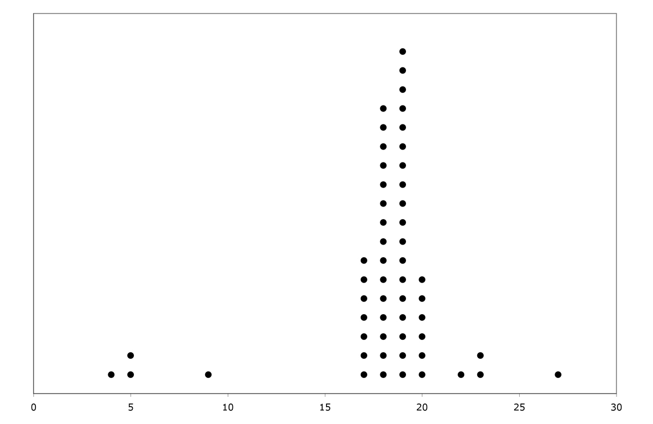
Here is the average
But really, most of the numbers are in this area, and are not evenly distributed throughout the range.
And here is the range

Slide 11
The Standard Deviation is a number that measures how far away each number in a set of data is from their mean.
If the Standard Deviation is large, it means the numbers are spread out from their mean.
If the Standard Deviation is small, it means the numbers are close to their mean.
large,
small,

Slide 12
Let’s look at how we calculate this.

Slide 13
Here are the scores on the math quiz for Team A:
72
76
80
80
81
83
84
85
85
89
Average:
81.5

Slide 14
The Standard Deviation measures how far away each number in a set of data is from their mean.
For example, start with the lowest score, 72. How far away is 72 from the mean of 81.5?
72 - 81.5 = - 9.5
- 9.5

Slide 15
Or, start with the highest score, 89. How far away is 89 from the mean of 81.5?
89 - 81.5 = 7.5
- 9.5
7.5

Slide 16
So, the first step to finding the Standard Deviation is to find all the distances from the mean.
Distance from Mean
72
76
80
80
81
83
84
85
85
89
-9.5
7.5

Slide 17
So, the first step to finding the Standard Deviation is to find all the distances from the mean.
Distance from Mean
72
76
80
80
81
83
84
85
85
89
- 9.5
- 5.5
- 1.5
- 1.5
- 0.5
1.5
2.5
3.5
3.5
7.5

Slide 18
Next, you need to square each of the distances to turn them all into positive numbers
Distance from Mean
Distances Squared
72
76
80
80
81
83
84
85
85
89
- 9.5
- 5.5
- 1.5
- 1.5
- 0.5
1.5
2.5
3.5
3.5
7.5
90.25
30.25

Slide 19
Next, you need to square each of the distances to turn them all into positive numbers
Distance from Mean
Distances Squared
72
76
80
80
81
83
84
85
85
89
- 9.5
- 5.5
- 1.5
- 1.5
- 0.5
1.5
2.5
3.5
3.5
7.5
90.25
30.25
2.25
2.25
0.25
2.25
6.25
12.25
12.25
56.25

Slide 20
Add up all of the distances
Distance from Mean
Distances Squared
72
76
80
80
81
83
84
85
85
89
- 9.5
- 5.5
- 1.5
- 1.5
- 0.5
1.5
2.5
3.5
3.5
7.5
90.25
30.25
2.25
2.25
0.25
2.25
6.25
12.25
12.25
56.25
Sum:
214.5

Slide 21
Divide by (n) where n represents the amount of numbers you have.
Distance from Mean
Distances Squared
72
76
80
80
81
83
84
85
85
89
- 9.5
- 5.5
- 1.5
- 1.5
- 0.5
1.5
2.5
3.5
3.5
7.5
90.25
30.25
2.25
2.25
0.25
2.25
6.25
12.25
12.25
56.25
Sum:
214.5
(10)
= 21.45

Slide 22
Finally, take the Square Root of the average distance
Distance from Mean
Distances Squared
72
76
80
80
81
83
84
85
85
89
- 9.5
- 5.5
- 1.5
- 1.5
- 0.5
1.5
2.5
3.5
3.5
7.5
90.25
30.25
2.25
2.25
0.25
2.25
6.25
12.25
12.25
56.25
Sum:
214.5
(10)
= 21.45
= 4.63

Slide 23
This is the Standard Deviation
Distance from Mean
Distances Squared
72
76
80
80
81
83
84
85
85
89
- 9.5
- 5.5
- 1.5
- 1.5
- 0.5
1.5
2.5
3.5
3.5
7.5
90.25
30.25
2.25
2.25
0.25
2.25
6.25
12.25
12.25
56.25
Sum:
214.5
(10)
= 21.45
= 4.63

Slide 24
Now find the Standard Deviation for the other class grades
Distance from Mean
Distances Squared
57
65
83
94
95
96
98
93
71
63
- 24.5
- 16.5
1.5
12.5
13.5
14.5
16.5
11.5
- 10.5
-18.5
600.25
272.25
2.25
156.25
182.25
210.25
272.25
132.25
110.25
342.25
Sum:
2280.5
(10)
= 228.05
= 15.1

Slide 25
So – remember……

Slide 26
The Standard Deviation is a number that measures how far away each number in a set of data is from their mean.
If the Standard Deviation is large, it means the numbers are spread out from their mean.
If the Standard Deviation is small, it means the numbers are close to their mean.
large,
small,

